Slide 1
Image Generation with a Diffusion Model
Zeynep Gültuğ Aydemir
Deep Learning 14x050 - Mini Project

Slide 2
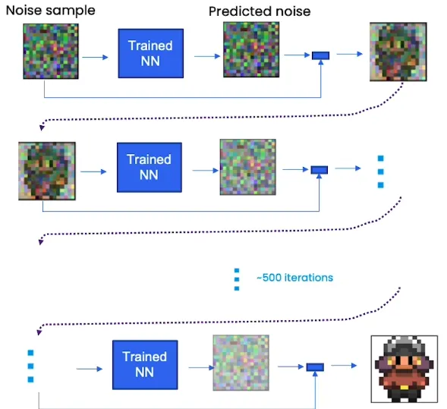
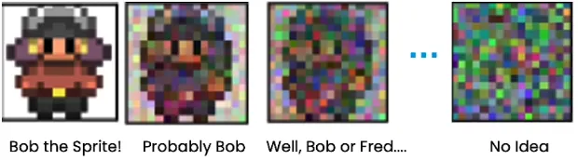
How Diffusion Models Work
Source: Deeplearning.ai, (1 August 2023), How Diffusion Models Work?

Slide 3
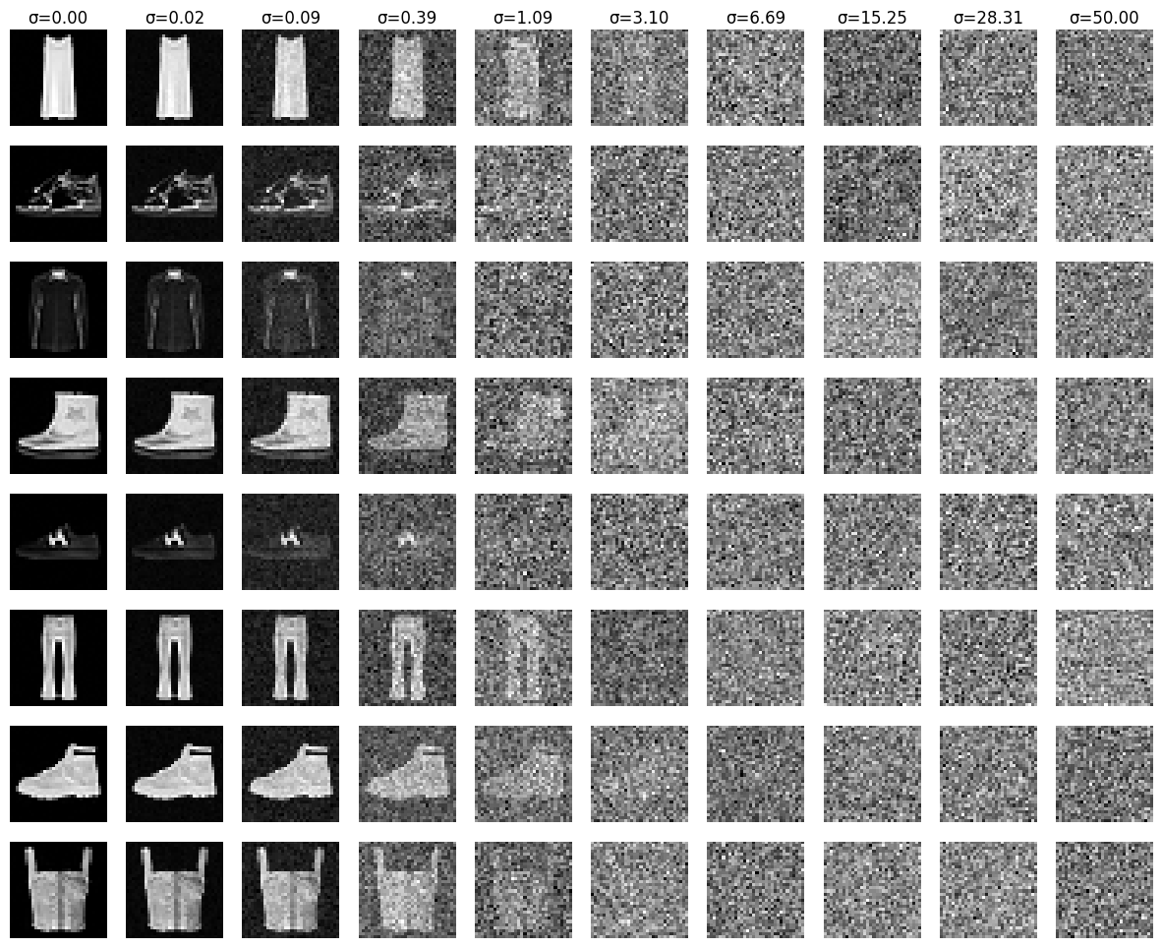
Noising Procedure
Gradually add Gaussian noise as 𝑦+𝜎⋅𝜖, where:
σ: Noise level (increases from left to right)
ϵ: Random noise sampled from a Gaussian distribution 𝑁(0,𝐼)
At high noise levels, the images should be unrecognizable and resemble random noise.
Data
Noise

Slide 4
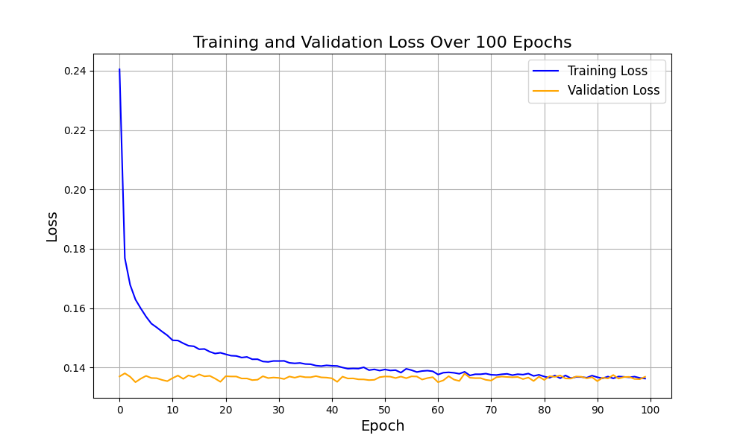
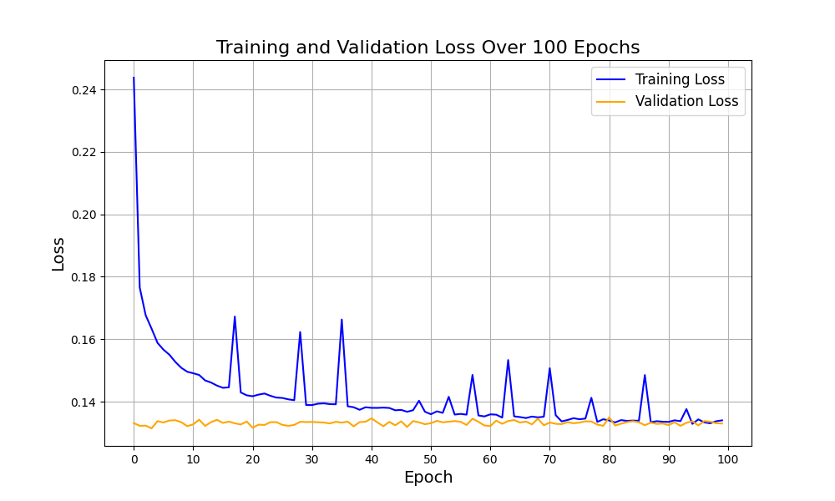
Training Pipeline
Pass the noisy image 𝑥 through the model:
Model learns to predict the residual noise.
Compute the target, output and MSE loss:
Target: Residual noise that was added to y
Output: Predicted noise component that needs to be removed from x
Optimize the model using backpropagation.

Slide 5
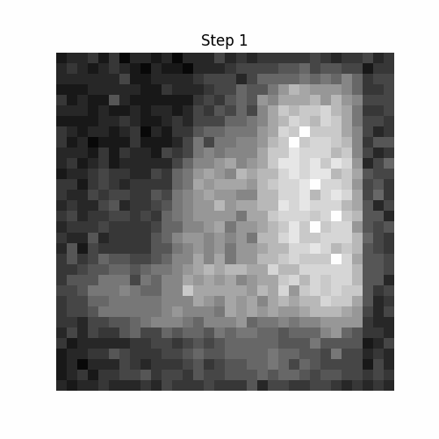
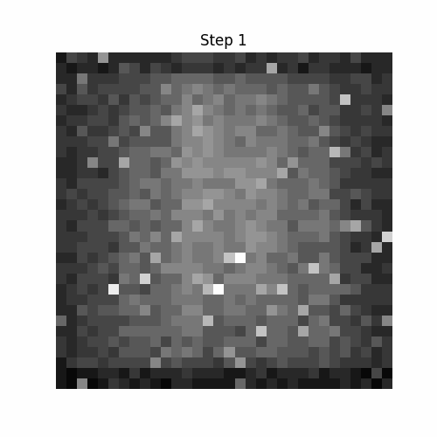
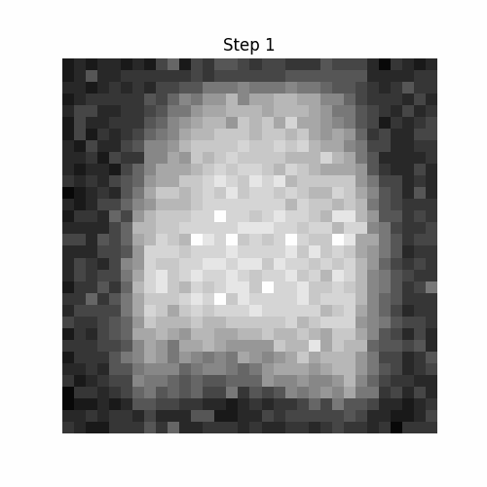
Sampling Procedure

Slide 6
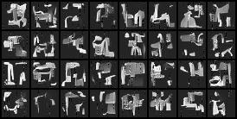
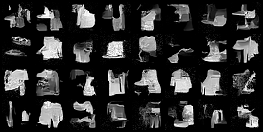
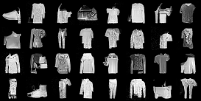
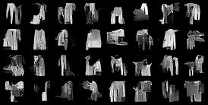
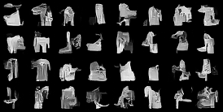
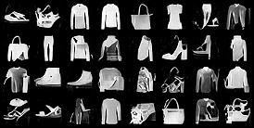
Model Improvements
Base Model - no noise conditioning
Conditional BatchNorm2d - noise conditioning + improved initialization

Slide 7
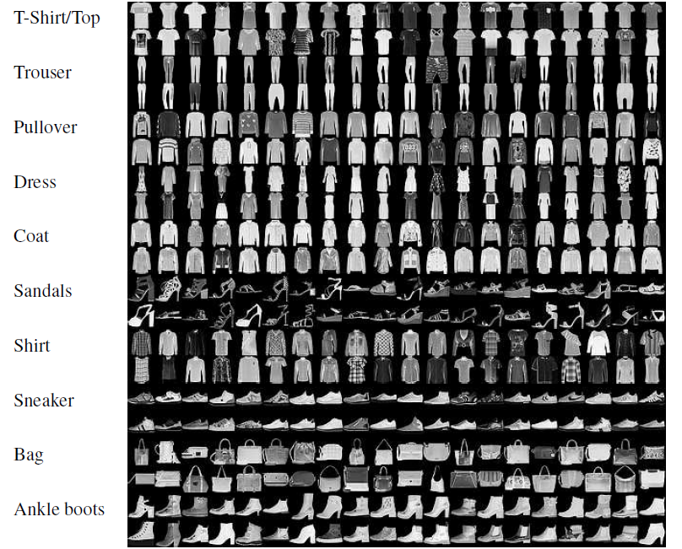
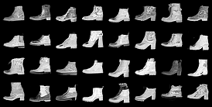
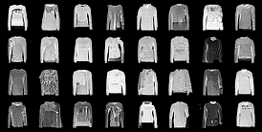
Class-Conditioning
Source: https://towardsdatascience.com/multi-label-classification-and-class-activation-map-on-fashion-mnist-1454f09f5925

Slide 8
Model Evaluation
Model | Parameters | Average FID
Base Model | nb_channels=64, num_blocks=8, cond_channels=32 (50ep) | 127.18
Base Model | nb_channels=128, num_blocks=8, cond_channels=64 (50ep) | 113.27
Cond. BatchNorm2d 1 | nb_channels=128, num_blocks=6, cond_channels=32 (50ep) | 113.73
Cond. BatchNorm2d 2 | nb_channels=128, num_blocks=8, cond_channels=64 (50ep) | 107.05
Class Conditional 1 | nb_channels=128, num_blocks=6, cond_channels=32 (50ep) | 89.56
Class Conditional 2 | nb_channels=128, num_blocks=8, cond_channels=64 (50ep) | 87.83
Class Conditional 3 | nb_channels=128, num_blocks=6, cond_channels=32 (100ep) | 89.88
Class Conditional 4 | nb_channels=128, num_blocks=8, cond_channels=64 (100ep) | 87.86

Slide 9
Class Conditional Model Evaluation
Model/Class | T-shirt | Trouser | Pullover | Dress | Coat | Sandal | Shirt | Sneaker | Bag | Boot
Model 1 | 133.04 | 53.28 | 80.15 | 75.14 | 82.55 | 113.3 | 86.5 | 83.14 | 120.5 | 68.08
Model 2 | 137.15 | 46.14 | 83.54 | 79.88 | 91.1 | 113.13 | 80.36 | 76.29 | 106.8 | 63.89
Model 3 | 135.52 | 55.20 | 90.01 | 73.28 | 78.87 | 114.8 | 91.26 | 84.59 | 104.88 | 70.23
Model 4 | 143.98 | 46.52 | 86.13 | 78.49 | 87.51 | 116.65 | 85.5 | 69.1 | 102.39 | 62.43

Slide 10
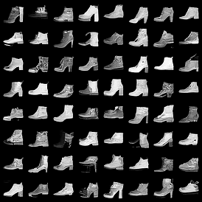
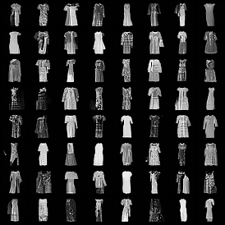
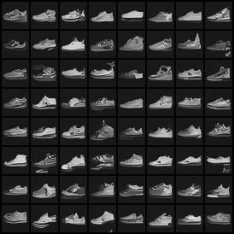
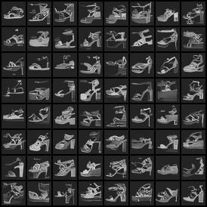
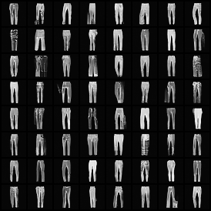
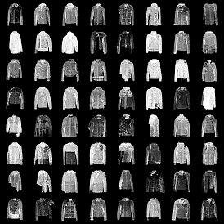
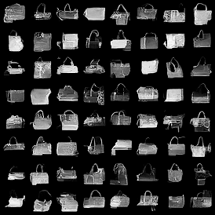
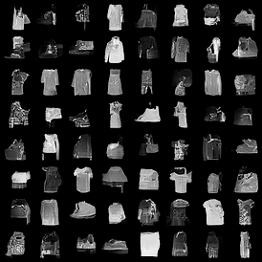
Final Results

Slide 11
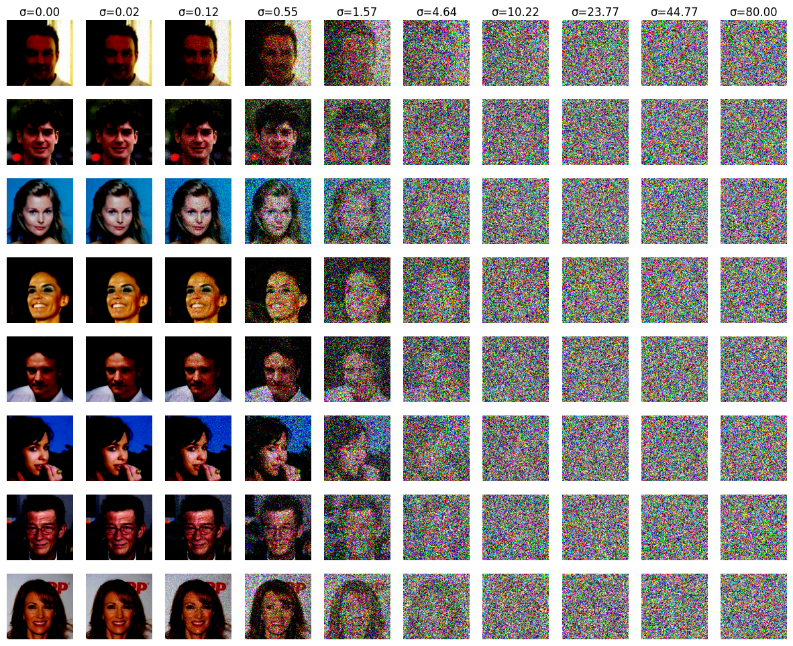
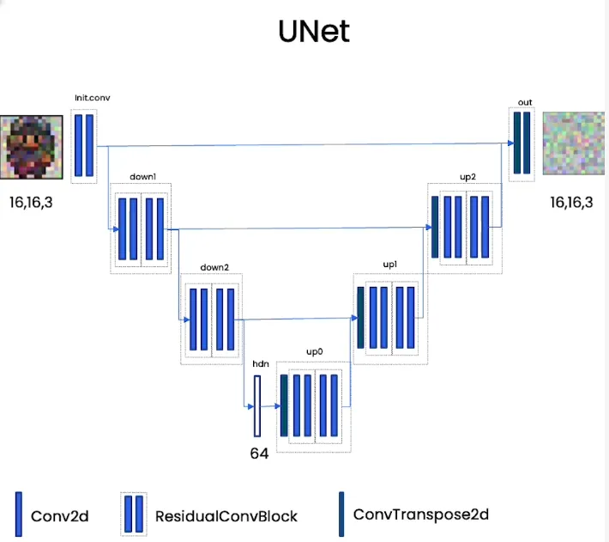
Possible Improvements
Investigate low performing classes
Stabilize loss curves with learning rate scheduler
Better architecture with UNet model
Face generation using CelebA
Source: DeepLearning.Ai, How Diffusion Models Work?, 1 August 2023

